Slide 1
Chapter 6
The Normal Distribution
(Part 2)

Slide 2
Why Sample the Population?
To contact the whole population would be time consuming.
The cost of studying all the items in a population may be prohibitive.
The physical impossibility of checking all items.
The destructive nature of certain tests.
The sample results are adequate.

Slide 3
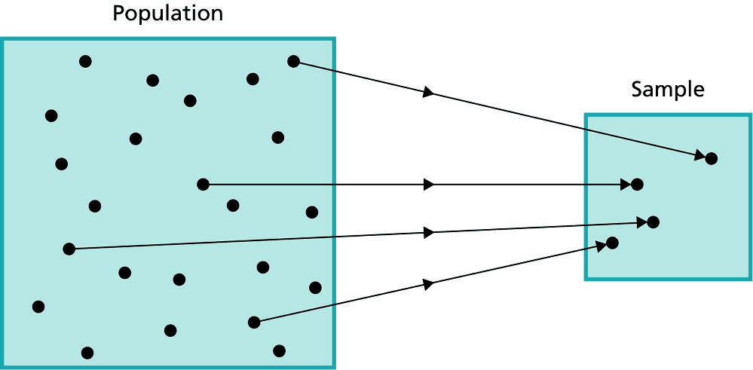
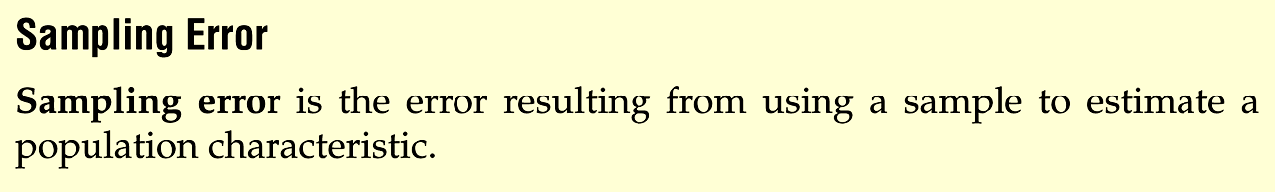
抽樣
(Sampling)
Parameter
Statistic

Slide 4
Sampling Error
Population data: 2, 6, 4, and 8.
Population mean: 5
Sampling (n = 2)
Selected sample: 2 and 4
Sample mean: 3
Sample error:

Slide 5
Distributions of Population and Sampling
Population Distribution
The population distribution is the probability distribution of the population data.
Sampling Distribution
In general, the probability distribution of a sample statistic is called its sampling distribution.
The probability distribution of is called sampling distribution of sample means.

Slide 6
Distribution of Sample Means
A sampling distribution of sample means is a distribution obtained by using the means computed from random samples of a specific size taken from a population.
Sampling error is the difference between the sample measure and the corresponding population measure due to the fact that the sample is not a perfect representation of the population.

Slide 7
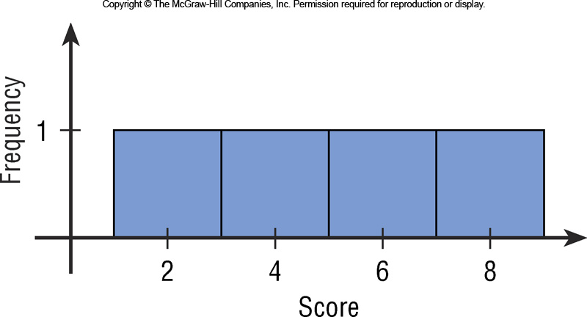
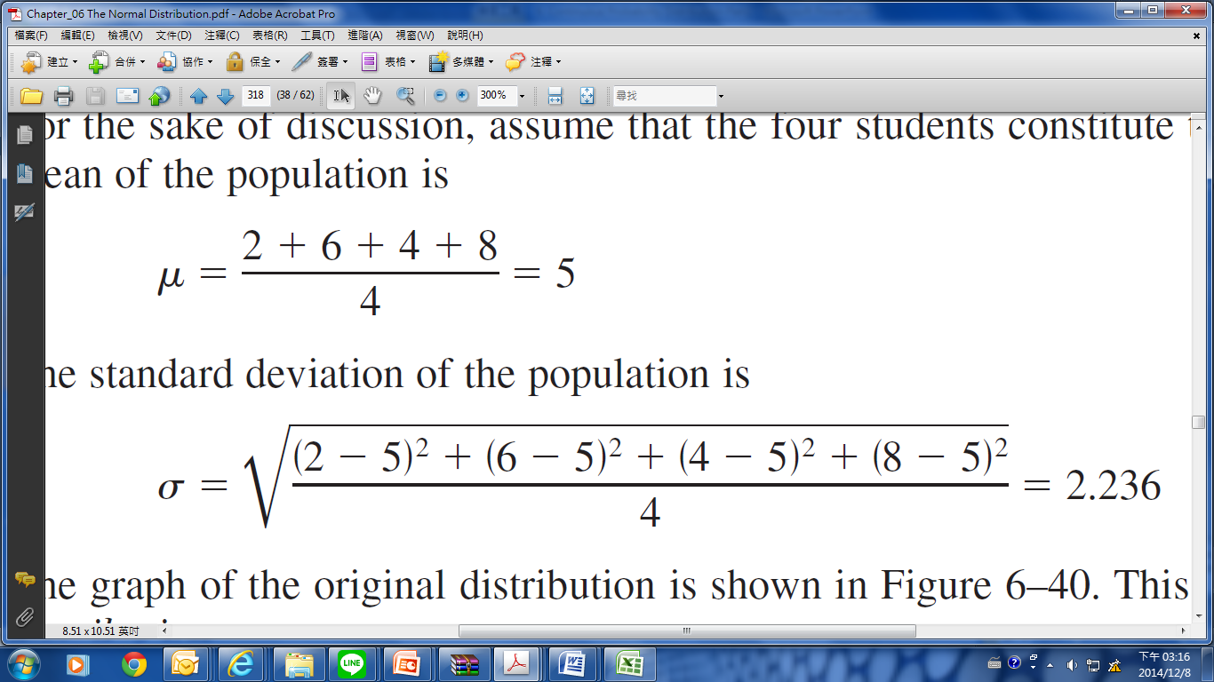
Example: (p.345)
Suppose a professor gave an 8-point quiz to a small class of four students. The results of the quiz were 2, 6, 4, and 8.
The mean of the population is
The standard deviation of the population is

Slide 8
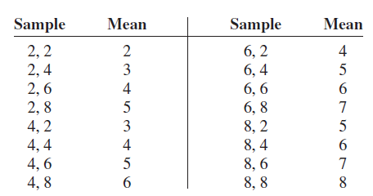
Example:
Population data: 2, 6, 4, and 8.
If all samples of size 2 are taken with replacement and the mean of each sample is found, the distribution is as shown.

Slide 9
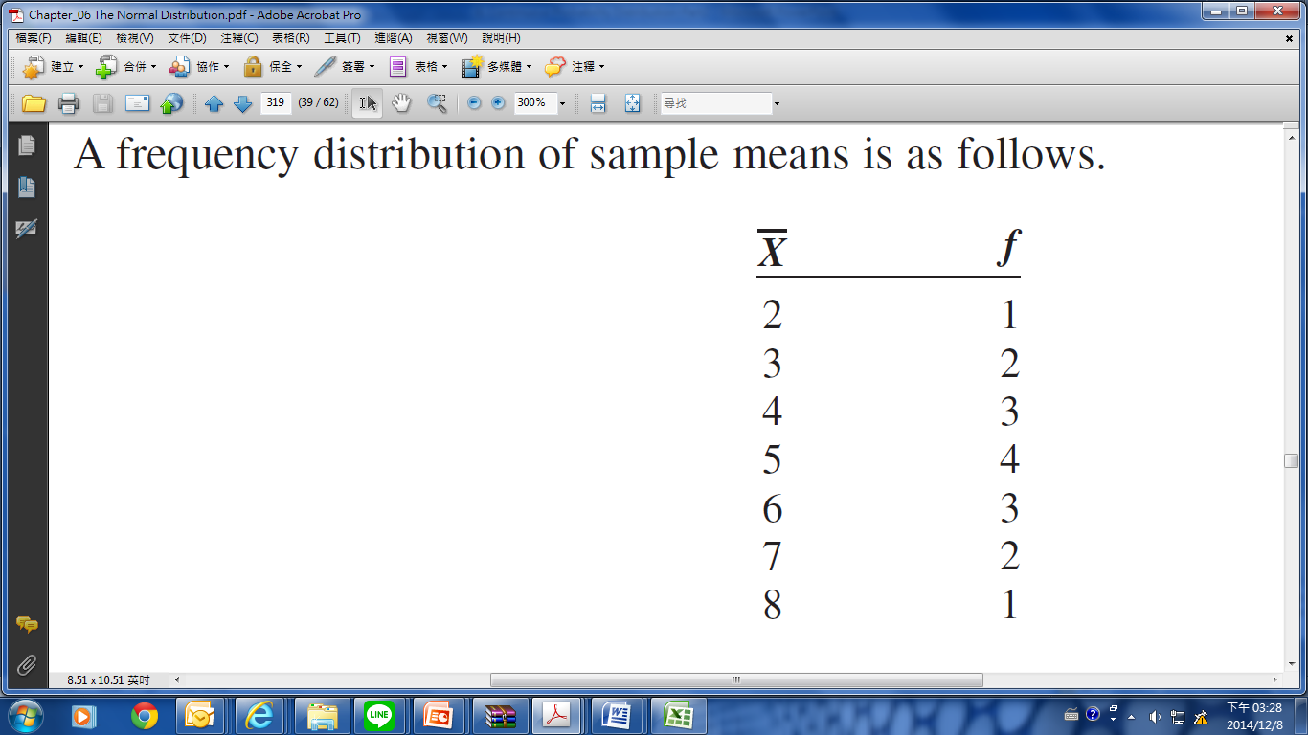
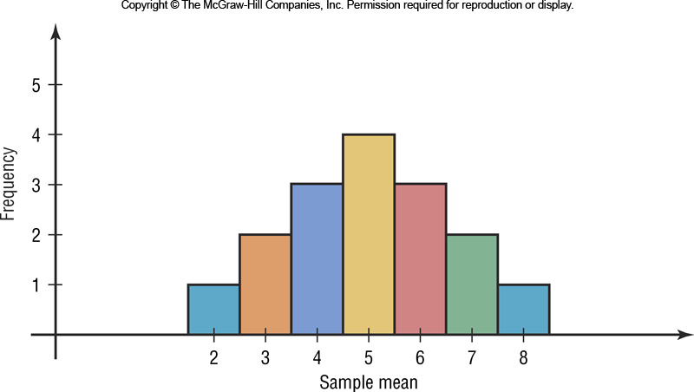
Example:
Population data: 2, 6, 4, and 8.
Sample size n = 2,
A frequency distribution of sample means

Slide 10
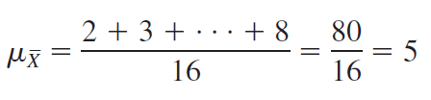
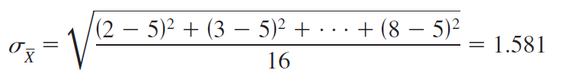
Example:
Population data: 2, 6, 4, and 8.
Sample size n = 2,
The mean of the sample means is
The standard deviation of the sample means is

Slide 11
Example
Population
Population mean:
Standard deviation
Sample (n=2)
Mean of the sample means:
Standard deviation of the sample means:

Slide 12
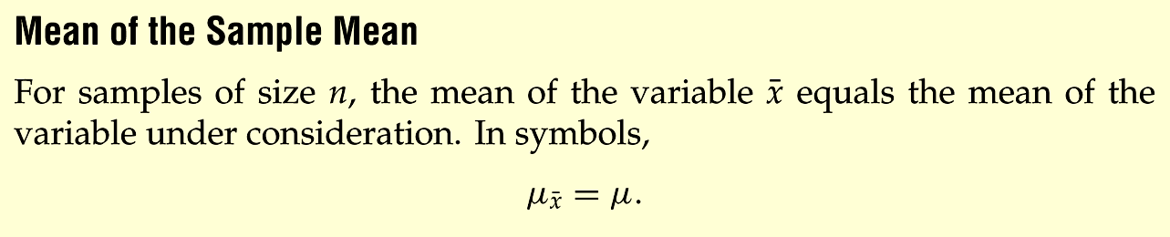
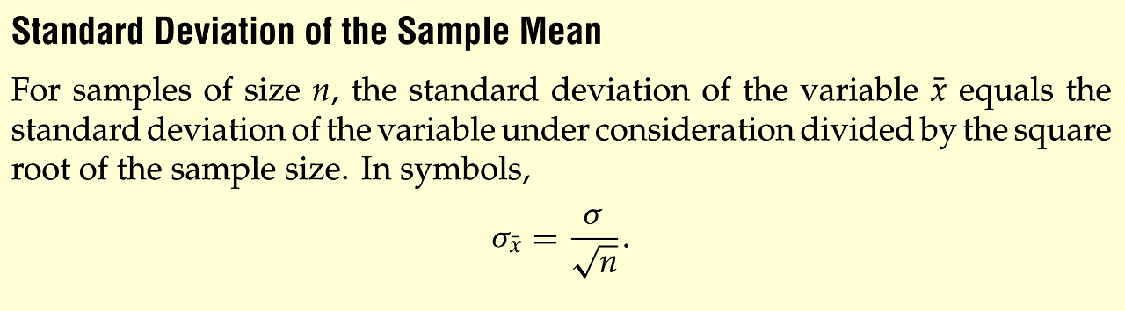
The Mean and Standard Deviation of the Sample Mean
Source: Weiss, Introductory Statistics
Notes:
Insert Formula 7.1, page 333

Slide 13
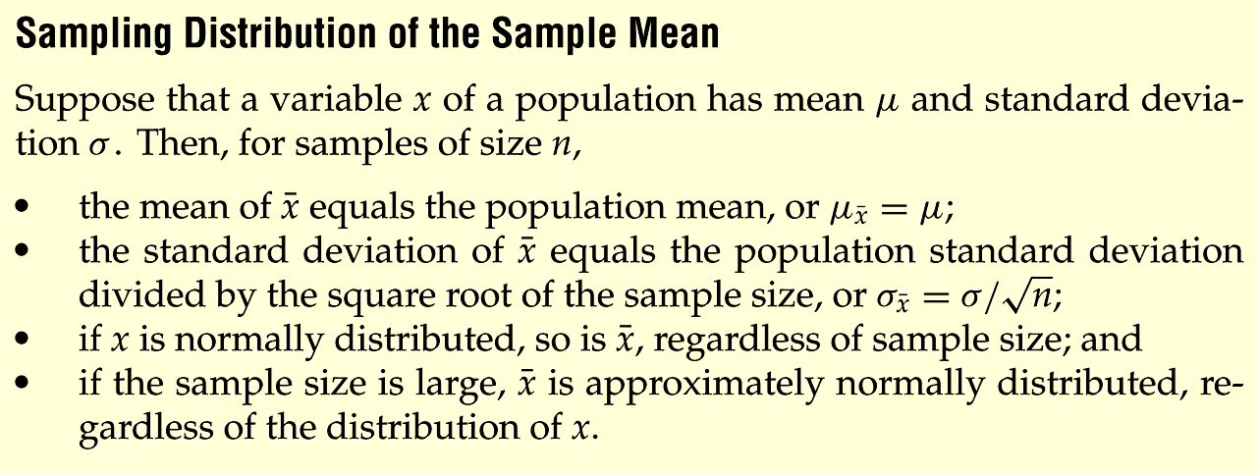
Properties of the Distribution of Sample Means
Sample size n≧30
➔ Central Limit Theorem
Notes:
Change to page 342

Slide 14
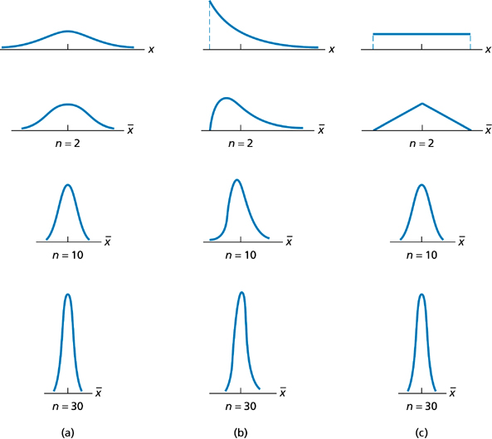
Notes:
Change to page 343

Slide 16
Section 6-3
The Central Limit Theorem
(CLT)

Slide 17
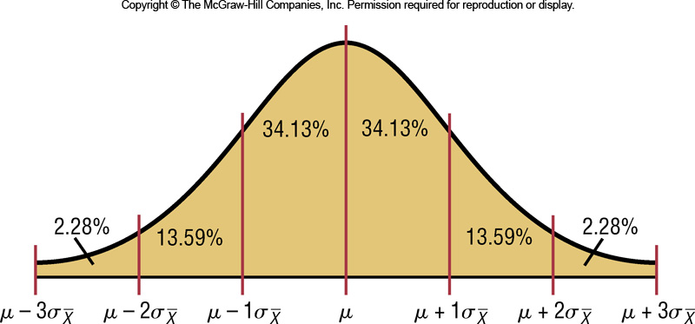
6-3 The Central Limit Theorem
A new formula must be used for the z values:

Slide 18
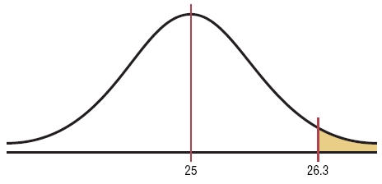
Example 6-13: Hours of Television
A. C. Neilsen reported that children between the ages of 2 and 5 watch an average of 25 hours of television per week. Assume the variable is normally distributed and the standard deviation is 3 hours. If 20 children between the ages of 2 and 5 are randomly selected, find the probability that the mean of the number of hours they watch television will be greater than 26.3 hours.

Slide 19
Example 6-13: Hours of Television
Since we are calculating probability for a sample mean, we need the Central Limit Theorem formula
Ans: The probability of obtaining a sample mean larger than 26.3 hours is 2.62%.

Slide 20
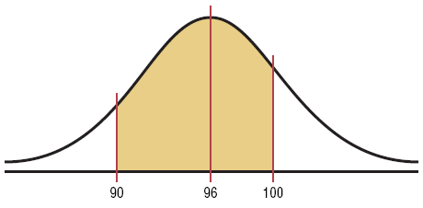
Example 6-14: Vehicle Age
The average age of a vehicle registered in the United States is 8 years, or 96 months. Assume the standard deviation is 16 months. If a random sample of 36 vehicles is selected, find the probability that the mean of their age is between 90 and 100 months.
Since the sample is 30 or larger, the normality assumption is not necessary.

Slide 21
Example 6-14: Vehicle Age
Ans: The probability of obtaining a sample mean between 90 and 100 months is 92.1%.

Slide 22
Example: Meat Consumption
The average number of pounds of meat that a person consumes per year is 218.4 pounds. Assume that the standard deviation is 25 pounds and the distribution is approximately normal.
Find the probability that a person selected at random consumes less than 224 pounds per year.
If a sample of 40 individuals is selected, find the probability the sample will be less than 224 pounds per year.

Slide 23
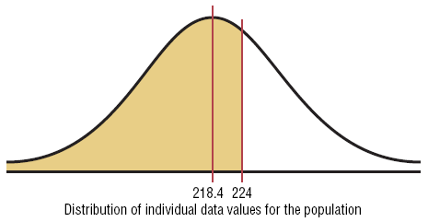
Example: Meat Consumption
a. Find the probability that a person selected at random consumes less than 224 pounds per year.
Hence, the probability of selecting an individual who consumes less than 224 pounds of meat per year is 0.5871, or 58.71%.

Slide 24
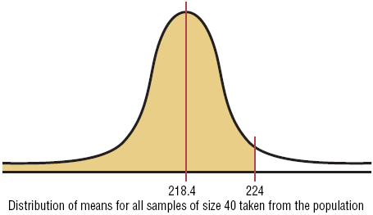
Example: Meat Consumption
The average number of pounds of meat that a person consumes per year is 218.4 pounds. Assume that the standard deviation is 25 pounds and the distribution is approximately normal.
b. If a sample of 40 individuals is selected, find the probability the sample will be less than 224 pounds per year.
Hence, the probability that the mean of a sample of 40 individuals is less than 224 pounds per year is 0.9222, or 92.22%.

Slide 26
Section 6-4
The Normal Approximation to the Binomial Distribution

Slide 27
The Normal Approximation to the Binomial Distribution
A normal distribution is often used to solve problems that involve the binomial distribution since when n is large (say, 100), the calculations are too difficult to do by hand using the binomial distribution.

Slide 28
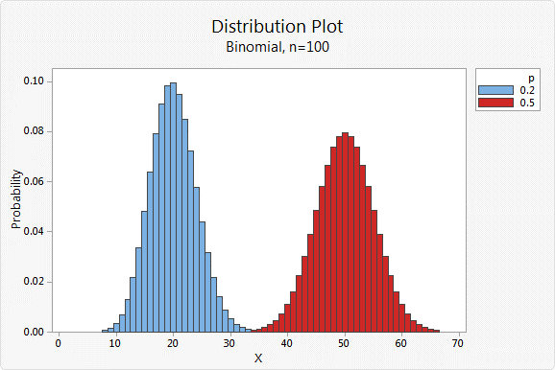

Slide 29
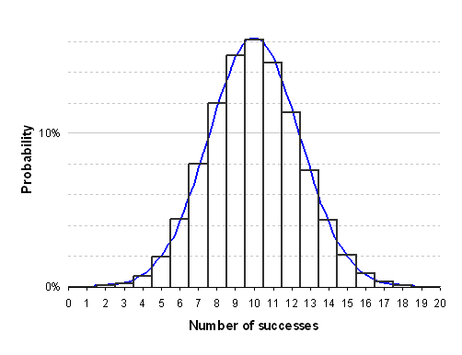
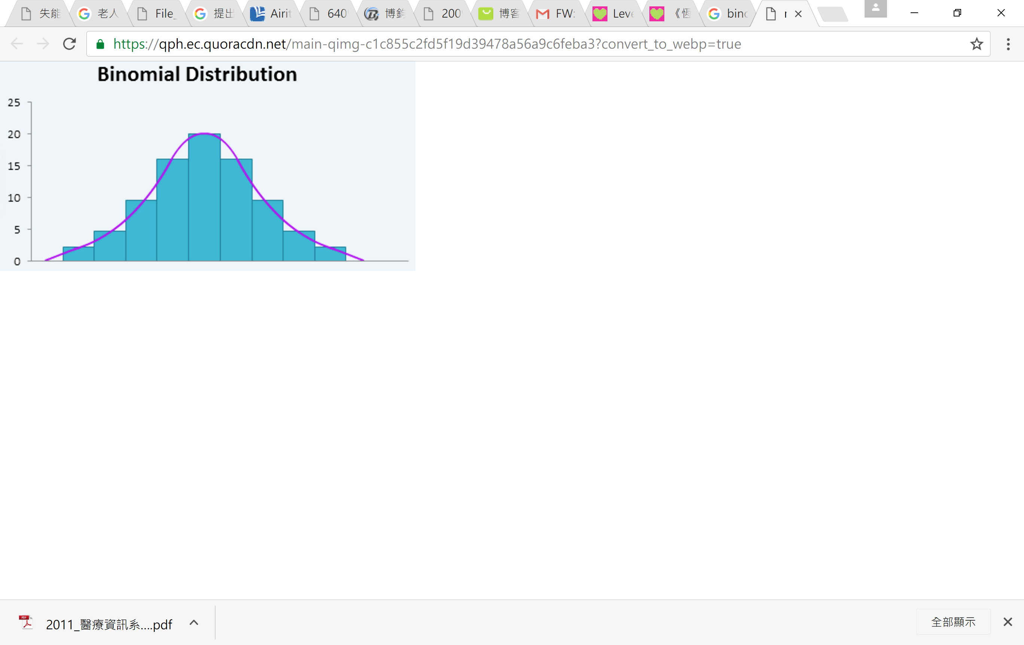

Slide 30
The Normal Approximation to the Binomial Distribution
The normal approximation to the binomial is appropriate when np > 5 and nq > 5 .
In addition, a correction for continuity may be used in the normal approximation to the binomial.
The continuity correction means that for any specific value of X, say 8, the boundaries of X in the binomial distribution (in this case, 7.5 to 8.5) must be used.

Slide 31
The Normal Approximation to the Binomial Distribution
Binomial
When finding:
P(X = a)
P(X ≥ a)
P(X > b)
P(X ≤ c)
P(X < d)
Normal
Use:
P(a – 0.5 < X < a + 0.5)
P(X > a – 0.5)
P(X > b + 0.5)
P(X < c + 0.5)
P(X < d – 0.5)

Slide 32
常態分配逼近二項分配
設X為二項隨機變數，且X～B(n,p)，當np≥5，則
方世榮，統計學導論，華泰書局

Slide 33
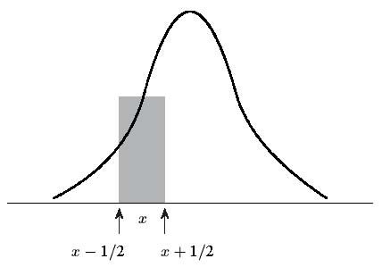
連續性修正因子 1/2
連續性修正因子±1/2

Slide 34
連續性修正因子 2/2
設X～B(n,p)，當np≥5且n(1–P)≥5，則存在下列近似式
P(X≤d)
P(X≥c)
P(c≤X≤d)
式中μ=n．p，σ=

Slide 35
The Normal Approximation to the Binomial Distribution
Procedure Table
Step 1: Check to see whether the normal approximation can be used.
Step 2: Find the mean µ and the standard deviation σ.
Step 3: Write the problem in probability notation, using X.
Step 4: Rewrite the problem by using the continuity correction factor, and show the corresponding area under the normal distribution.
Step 5: Find the corresponding z values.
Step 6: Find the solution.

Slide 36
Example 6-16: Reading While Driving
A magazine reported that 6% of American drivers read the newspaper while driving. If 300 drivers are selected at random, find the probability that exactly 25 say they read the newspaper while driving.
Here, p = 0.06, q = 0.94, and n = 300.
Step 1: Check to see whether a normal approximation can be used.
np = (300)(0.06) = 18 and nq = (300)(0.94) = 282
Since np ≥ 5 and nq ≥ 5, we can use the normal distribution.
Step 2: Find the mean and standard deviation.
µ = np = (300)(0.06) = 18

Slide 37
Example 6-16: Reading While Driving
A magazine reported that 6% of American drivers read the newspaper while driving. If 300 drivers are selected at random, find the probability that exactly 25 say they read the newspaper while driving.
At least 25
Less than 20
Between 16 and 22
µ = np = (300)(0.06) = 18

Slide 38
Example 6-16: Reading While Driving
Step 3: Write in probability notation.
Step 4: Rewrite using the continuity correction factor.
Step 5: Find the solution
Hence, the probability that exactly 25 people read the newspaper while driving is 2.27%.

Slide 39
Example 6-17: Ragweed Allergies
Ten percent of Americans are allergic to ragweed. If a random sample of 200 people is selected find the probability that 10 or more will be allergic to ragweed.
Step 1: Whether a normal approximation can be used?
Here p = 0.10, q = 0.90, and n = 200
np = (200)(0.10) = 20 and nq = (200)(0.90) = 180
Since np ≥ 5 and nq ≥ 5, we can use the normal distribution.
Step 2: Find the mean and standard deviation.
µ = np = (200)(0.10) = 20

Slide 40
Example 6-17: Ragweed Allergies
Step 3: Write in probability notation.
Step 4: Rewrite using the continuity correction factor.
P(X > 9.5)
Step 5: Find the corresponding z value and solution.
In a random sample of 200 Americans, the probability of 10 or more being allergic to ragweed is 99.34%.
P(X ≥ 10)

